Slide 1
Title IX
Review and Announcements
Teresa Tumbaga, Title IX and EEO/AA Coordinator
August 20, 2019

Slide 2
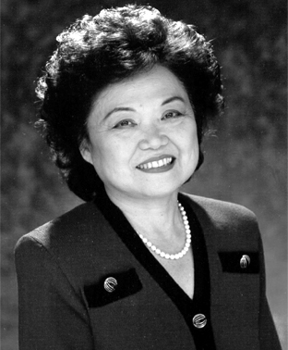
Title IX
“No person in the United States shall, on the basis of sex, be excluded from participation in, be denied the benefits of, or be subjected to discrimination under any education program or activity receiving Federal financial assistance.”
Prohibits discrimination on the basis of sex

Slide 3
Applies to all aspects of education
Recruitment
Admissions
Counseling
Athletics
Financial Aid
Pregnant & parenting students
Employment
Discipline
Sex-based harassment
Sex Discrimination
Sexual Harassment
Sexual Violence

Slide 4
Title IX and University Policy & Procedure on
Sex Discrimination and Gender-Based Violence
(E.P. 1.204) Prohibit:
Sex Discrimination
Sexual Harassment
Gender-Based Harassment
Sexual Exploitation
Sexual Assault
Domestic Violence
Dating Violence
Stalking
Retaliation
Failure to Comply with Terms of Interim Measures
Link for policy: https://www.hawaii.edu/policy/docs/temp/ep1.204.pdf

Slide 5
Title IX and Your Role
If someone discloses sex discrimination or gender-based violence to you;
or you become aware of an incident
Unless you are a Confidential Resource or Confidential Advocate,
you cannot promise confidentiality and are required to inform
the Title IX Coordinator.
You can promise privacy, i.e., that the information will be shared
with as few people as possible, only on a need-to-know basis
What can you promise?

Slide 6
How Could You Become Aware of an Incident?
Someone reports an incident to you or discloses information to you
You observe the incident or conduct
You become aware of an incident through a third party

Slide 7
What Should You Inform the Title IX Coordinator?
Names of persons involved, including witnesses
Description of incident(s), including date, time, location
Any other evidence
Remember:
You do not need to make your own assessment
as to whether an actual violation occurred

Slide 8
Basics
If someone comes to you to report
First
Disclose that you cannot promise confidentiality
Next
If the individual wants to remain confidential
Provide contact information
for Confidential Resources
If the individual wants to report
Provide contact information
for Title IX Coordinators
OR

Slide 9
How to Report a Title IX Case
Teresa Tumbaga,
Title IX Coordinator
One Stop Center, Room 201C
Phone: (808) 245-8395
Email: tumbagat@hawaii.edu
Or contact
a Deputy Title IX Coordinator
Link: https://report.system.hawaii.edu/student

Slide 10
On Campus Title IX Resources
Title IX Coordinators
Title IX Coordinators
Confidential Resources
Teresa Tumbaga, Title IX Coordinator
One Stop Center, Room 201C
Phone: (808) 245-8395
Email: tumbagat@hawaii.edu
Keahi Kahui, Confidential Advocate
Kaua`i Community College, Wellness Center
Phone: (808) 278-3508 [call or text]
Email: keahi@ywcakauai.org
Margaret Sanchez, Deputy Title IX Coordinator for Students
One Stop Center, Room 201B
Phone: (808) 245-8274
Email: masanche@hawaii.edu
Brian Kohatsu, Mental Health Counselor
Kaua`i Community College, One Stop Center, 201D
Phone: (808) 245-8314
Email: kohatsub@hawaii.edu
JoRae Baptiste, Deputy Title IX Coordinator
for Employees
One Stop Center, Room 106H
Phone: (808) 245-8323
Email: jorae@hawaii.edu

Slide 11
Title IX Office
Not a confidential source of support. Information will be kept as private as possible
Can provide help, information, and/or resources
If informed of sex discrimination, sexual misconduct, and/or gender-based violence, Coordinators have a duty to follow up to determine the appropriate response, which could include a formal investigation.
Individuals will not be forced to participate or share information.

Slide 12
On Campus Title IX Resources
Title IX Coordinators
Title IX Coordinators
Confidential Resources
Teresa Tumbaga, Title IX Coordinator
One Stop Center, Room 201C
Phone: (808) 245-8395
Email: tumbagat@hawaii.edu
Keahi Kahui, Confidential Advocate
Kaua`i Community College, Wellness Center
Phone: (808) 278-3508 [call or text]
Email: keahi@ywcakauai.org
Margaret Sanchez, Deputy Title IX Coordinator for Students
One Stop Center, Room 201B
Phone: (808) 245-8274
Email: masanche@hawaii.edu
Brian Kohatsu, Mental Health Counselor
Kaua`i Community College, One Stop Center, 201D
Phone: (808) 245-8314
Email: kohatsub@hawaii.edu
JoRae Baptiste, Deputy Title IX Coordinator
for Employees
One Stop Center, Room 106H
Phone: (808) 245-8323
Email: jorae@hawaii.edu

Slide 13
Confidential Help
The Confidential Advocate and Confidential Resource create safe and confidential spaces for individuals to determine their options
Receive assistance and retain control of the decision to report an incident to Kaua'i Community College and/or the police
Opt to pursue a non-confidential report with Kaua'i Community College at any time

Slide 14
Confidential Help:
Kaua'i Community College Confidential Advocate
Keahi Kahui
Wellness Center
(808) 278-3508 [call or text]
keahi@ywcakauai.org
On Campus - Mon (10 am-2 pm) & Tues (9 am-1pm)
On Call - Wed (10 am-2 pm) & Thurs (1-5 pm)
YWCA Crisis Intervention Specialist
Available to students and employees
All services are free of charge
Services Include:
Education on sexual harassment, sexual assault and domestic & dating violence
On campus support, including assistance with reporting to the College or Interim Measures
Off campus advocacy, including assisting with TRO’s, reporting to the police, or accompaniment to forensic medical exams

Slide 15
Confidential Help:
Kaua'i Community College Confidential Resource
Brian Kohatsu
KCC Mental Health Counselor
Available to students
All services are free of charge
One Stop Center, 201D
(808) 245-8314
kohatsub@hawaii.edu
Services Include:
Help with adjusting to college life and learning health ways to cope with stress
Assistance with coping with crisis (including domestic/dating violence, sexual assault, and thoughts of suicide)
Treatment for depression, anxiety, and substance abuse
Psychiatric referrals

Slide 16
Reminder: Your Rights
Individuals may always choose to report an incident to law enforcement, to Kaua'i Community College, to both, or to neither
Support and resources at Kaua'i Community College are always available to a reporting party, regardless of the chosen reporting option.
They can also direct you to off-campus resources.
Individuals always have the right to initiate a civil process.

Slide 17
Bottom Line
The University of Hawaii is committed to providing safe and respectful campus environments that are free from sex discrimination and gender-based violence,
including sexual harassment, gender-based harassment, sexual exploitation, sexual assault, domestic violence, dating violence, and stalking.

Slide 18
Announcements
2019 University of Hawai'i Campus Climate Survey Update
Estimated preliminary results show the final useable response rate at Kaua'i Community College increased
Estimated preliminary results show the final useable response rate for the University of Hawai'i also increased
Final data will be released in November

Slide 19
Announcements
Upcoming Training
September 2019………………………Online Title IX Training
Friday, October 11, 2019…………… Preventing Discrimination on Campus
9:00 – 11:00 am; or 1:30 – 3:30 pm
OCET 106 C & D
To Be Scheduled…...………….………Title IX & Domestic/Dating Violence
Classroom introductions or
Individualized sessions…….…………Contact Teresa Tumbaga

Slide 20
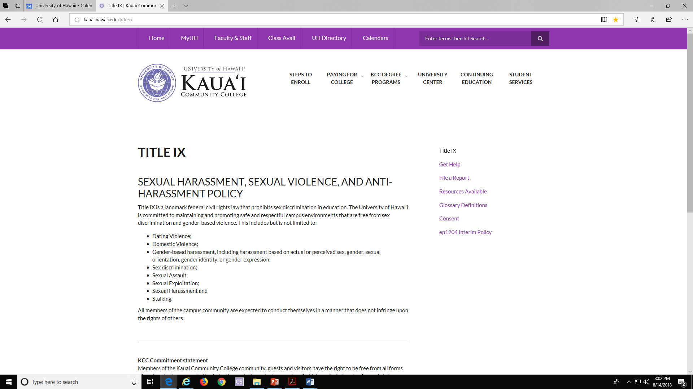
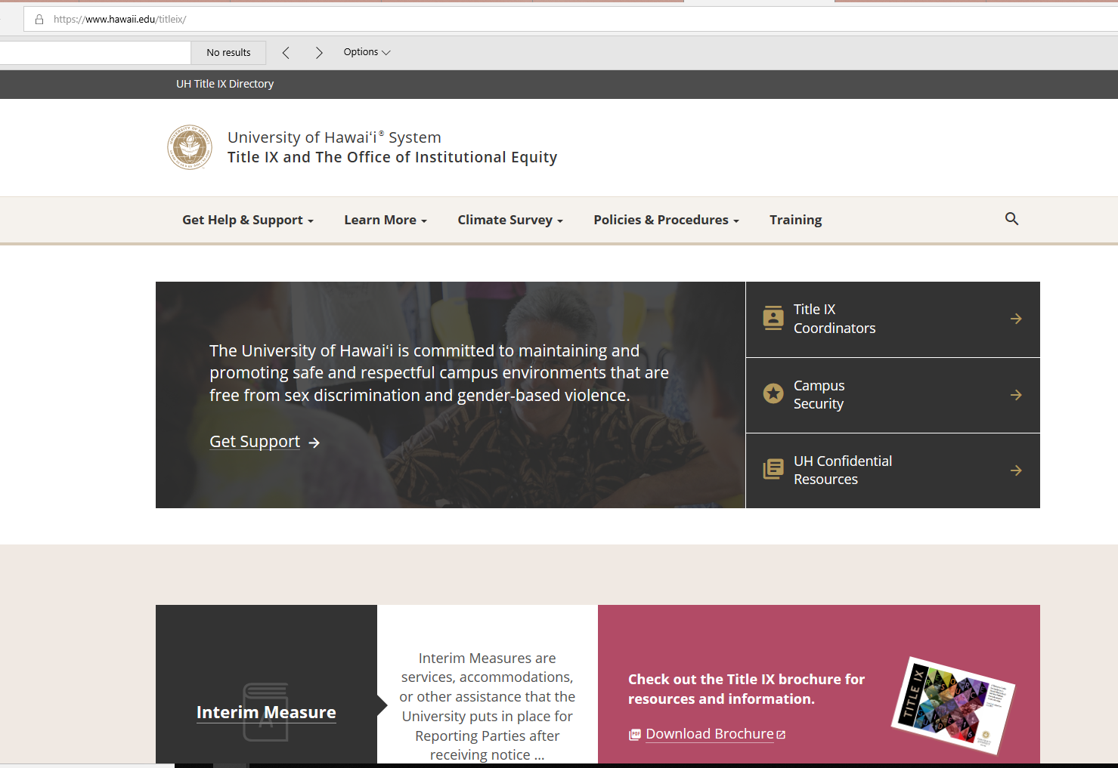
More Information
https://www.kauai.hawaii.edu/title-ix
https://www.hawaii.edu/titleix/

