Slide 1
Student Affairs
Kauai Community College Convocation
Fall 2019

Slide 2
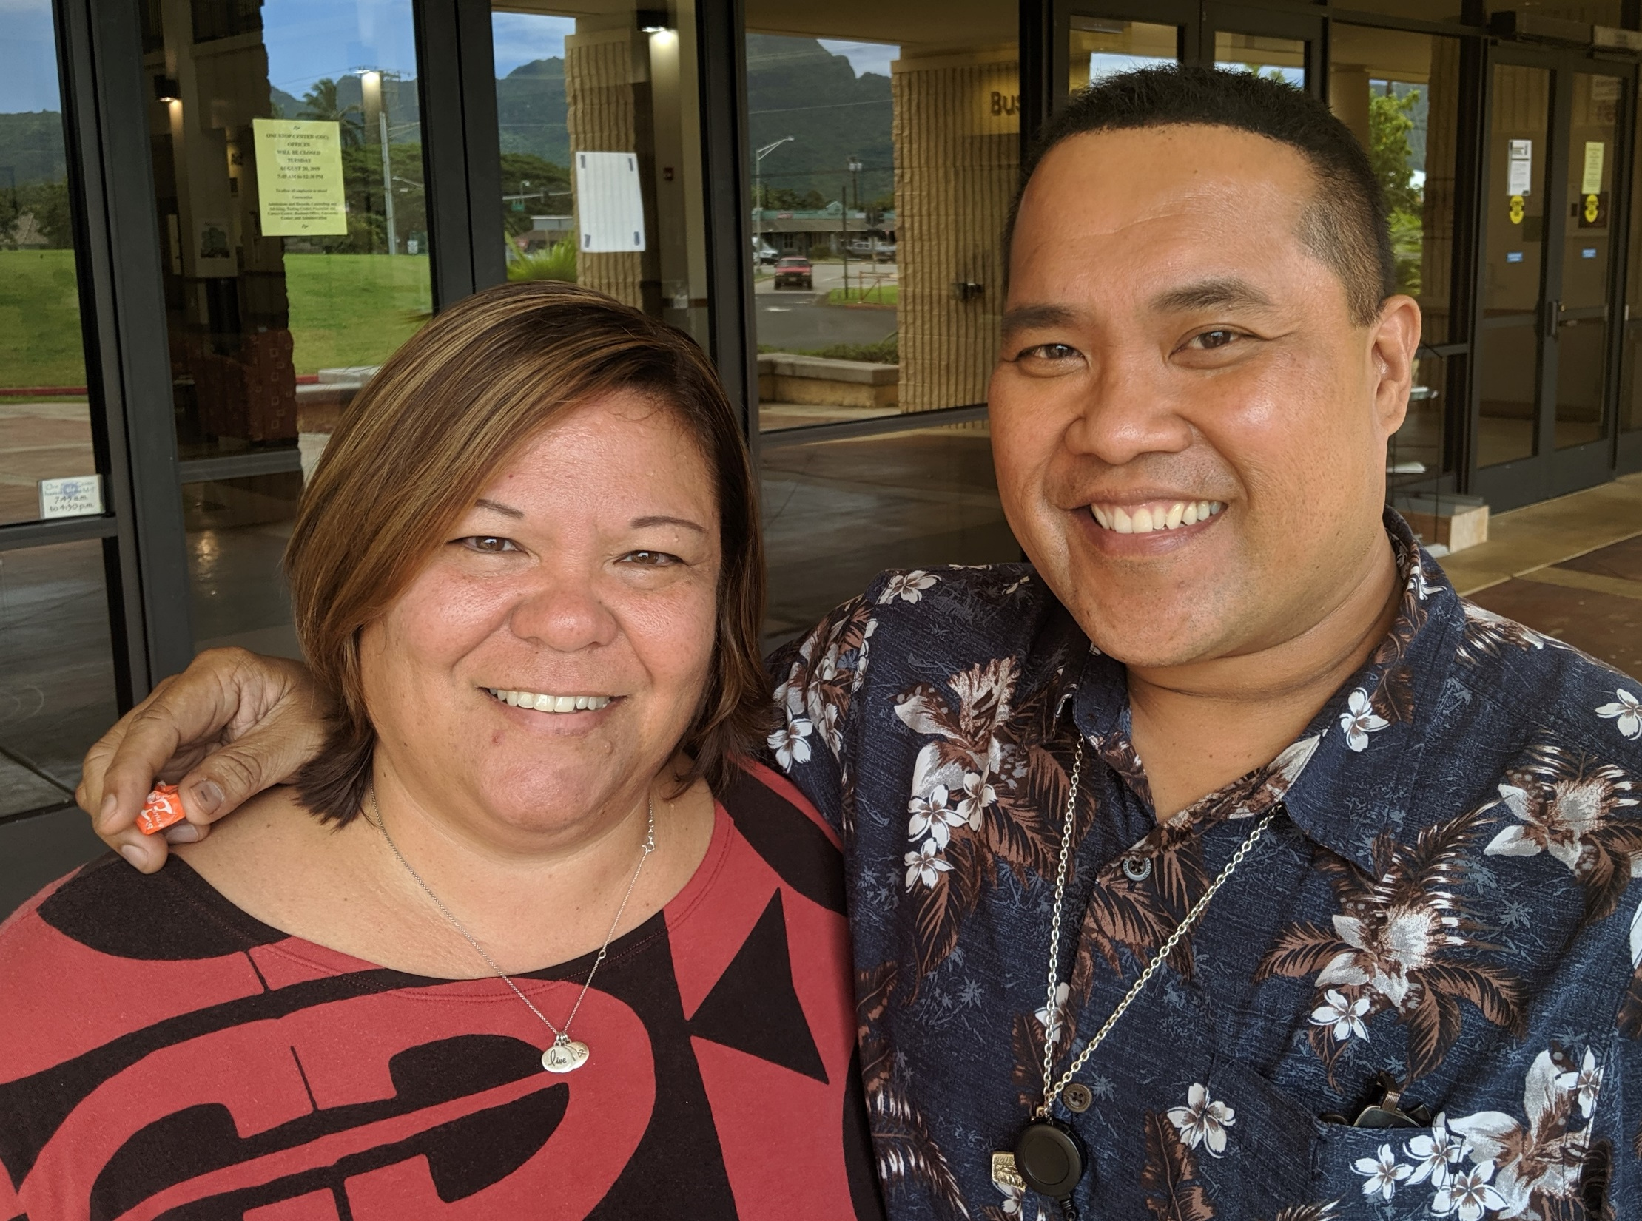
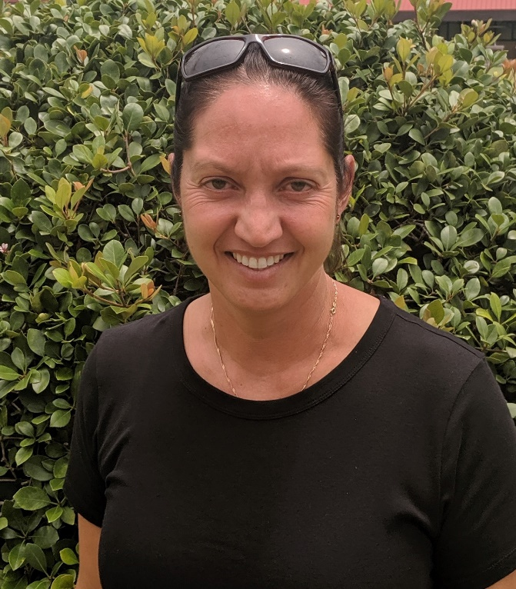
Hello and Goodbye

Slide 3
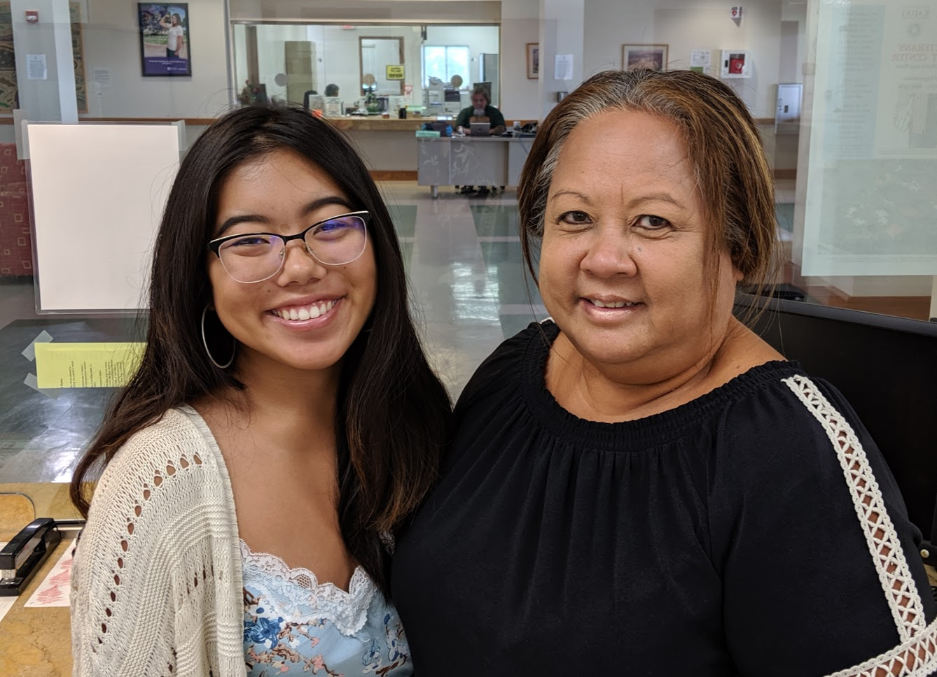
Admissions and Records
Increased involvement with Early
College students
Clarify Steps to Enroll – email to
students
Increased presence at High
Schools to register students at
High Schools for fall

Slide 4
Counseling
Onboarding Activities – Liaisons with DOE High Schools
Returning Adults - One Night to Success

Slide 5
Financial Aid
Increased the amount of scholarship
money awarded
Planned for 19-20 school year:
Adding FAFSA completion to New Student Orientation
Combining UH common scholarship application workshops
with FAFSA workshops with evening hours
Financial Aid nights at the high schools for seniors and
their parents

Slide 6
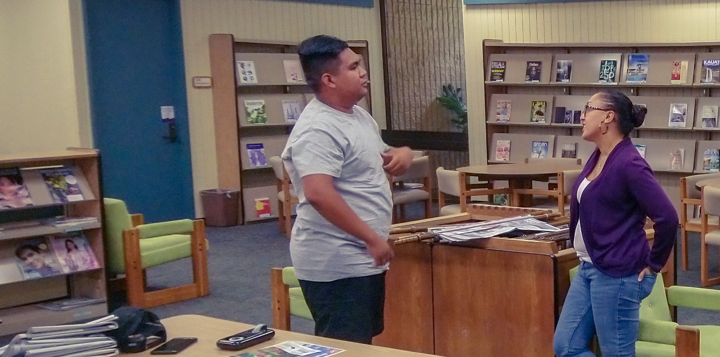
Library
Increased the number of Library Information Sessions given

Slide 7
Student Success
Welcome Tent
Mentor Program
Never Cancel Class
Academic Success Center
- ESL Support
Wai’ale’ale – 10th Anniversary

Slide 8
QFE – Integrated Career and Academic Services
#Findyour future 11th and 12th grades at KCC
High School Counselor Event at KCC
Enrollment Days at High Schools
Application Days at HS with Career Services
Placement Assessment at HS
Mandatory Academic Advising
October- November
September
November- December
February - March
April
Fall 2019 (for Spring 20)

