Slide 1
Convocation
August 2019
Welcome
Or
Welcome Back!

Slide 2
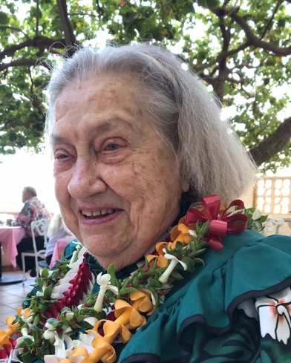
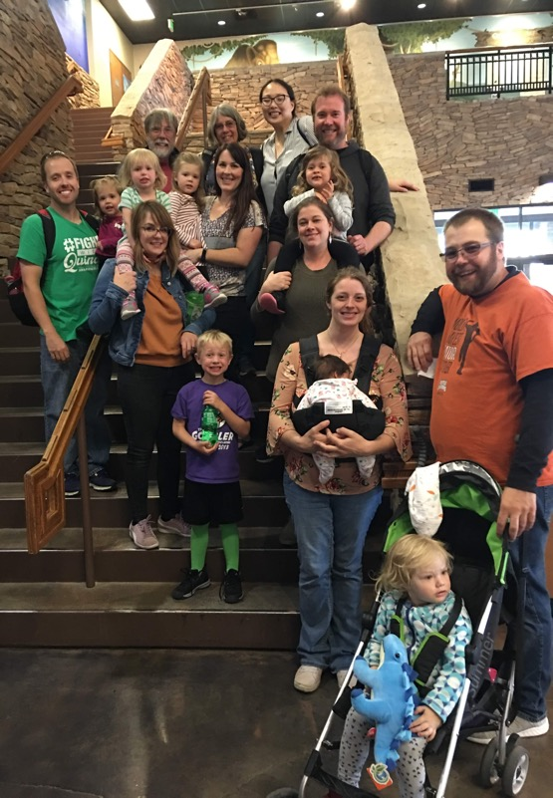
My Family

Slide 3
Kauaʻi Community College is a kahua that inspires, engages, and empowers learners and educators to enrich our community and our world.
Ke kū nei ke Kulanui Kaiāulu ma Kauaʻi ma ke ʻano he kahua e hoʻoulu, hoʻā, a hoʻoikaika ʻia ai ka ʻike a me ka naʻauao o nā kānaka aʻo aku a aʻo mai no ka hoʻowaiwai ʻana i ke kaiāulu a me ka honua.
ʻO ke kahua ma mua, ma hope ke kūkulu.
First comes the foundation, then comes the building.
(ʻŌlelo Noʻeau, number 2459)
Notes:
New mission—place based, and looking at the whole student.

Slide 4
Who are our students?
34%
9%
57%
Hawaiian or Part Hawaiian
Other
Filipino
Not Reported
Caucasian
Under 18
18 to 19
20 to 24
25 to 34
35 Plus
33%
23%
20%
13%
11%
Fall 2018 Census: https://public.tableau.com/shared/H3MGK8G76?:display_count=yes&:origin=viz_share_link N = 1,486
Notes:
Growth in Under 18 population and Not Reported Gender

Slide 5
Full-Time/Part-Time Students
Credits for KAU Only
Credits across System
FULL TIME
22%
28%
PART TIME
78%
72%
Fall 2018 Census N = 1,486
Notes:
Growing enrollments in Early College have increased part-time enrollment status.

Slide 6
Student Goals
Immediate
Highest
75%
63%
Earn an Associate or Certificate
Earn a Bachelors or Higher
12%
74%
Take courses to Transfer to Another College
From a Hawaiian Institution
Fall 2018 Census – Does not include Early College or non KAU Home Campus Enrollments N = 987

Slide 7
Historical Fall Enrollment
Fall Term Census
Notes:
Early College is on the rise. Dual axis chart used to also display SSH. Yesterday down 1.1% HEADCOUNT 1063, DOWN .1 % ssh

Slide 8
Fall Term Distance Education
Fall Term Census

Slide 9
Early College at Kauai CC
 | Number of Classes at Kauai HS | Number of Classes at Kapaa HS | Number of Classes at Waimea HS | Total Early College Enrollment
Fall 2015 | 1 | 3 | 2 | 131
Spring 2016 | 2 | 2 | 1 | 114
Fall 2016 | 3 | 4 | 5 | 206
Spring 2017 | 3 | 5 | 4 | 161
Fall 2017 | 2 | 8 | 6 | 218
Spring 2018 | 6 | 8 | 4 | 327
Fall 2018 | 6 | 13 | 12 | 442
Spring 2019 | 7 | 16 | 7 | 409
Fall 2019* | 6 | 12 | 4 | 85
*preliminary data as of 08/14/2019

Slide 10
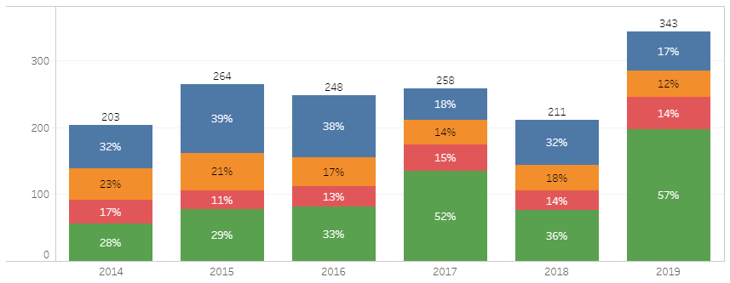
BIG YEAR FOR DEGREE COMPLETIONS!
Notes:
Added confetti.gif for fun – can be removed, just delete the images.

Slide 11
2019 KCC Results on UH Performance Measures
 | Weight | Goal | Actual
Degrees & Certificates | 30% | 277 | 343
NH (DC) | 10% | 72 | 126
STEM CC (DC) | 10% | 6 | 26
Pell (DC) | 10% | 149 | 187
150% Graduation* | 30% | 44.9
Transfers | 10% | 117 | 82
Total | 100%
Performance Funding Draft based on Spring EOS Data 08/14/2019
*Data updated in October
Did Not Meet
Met
Partially Met
Notes:
UPDATE: NEED 150% GRADUATION RATE and TOTAL $ FROM UH in chart

Slide 12
2018 KCC Results on UHCC Performance Measures
 | Weight | Goal | Actual
Degrees & Certificates | 35% | 277 | 343
NH (DC) | 10% | 72 | 126
STEM Total (DC) | 10% | 14 | 26
Pell (DC) | 10% | 149 | 187
Transfers | 35% | 215 | 296
Total | 100%
Performance Funding Draft based on Spring EOS Data 08/14/2019
Did Not Meet
Met
Partially Met

Slide 13
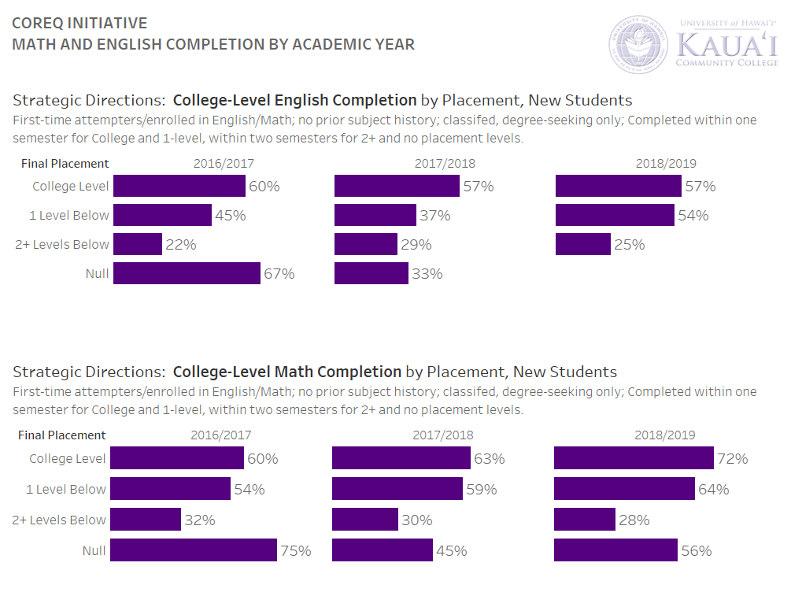

Slide 14
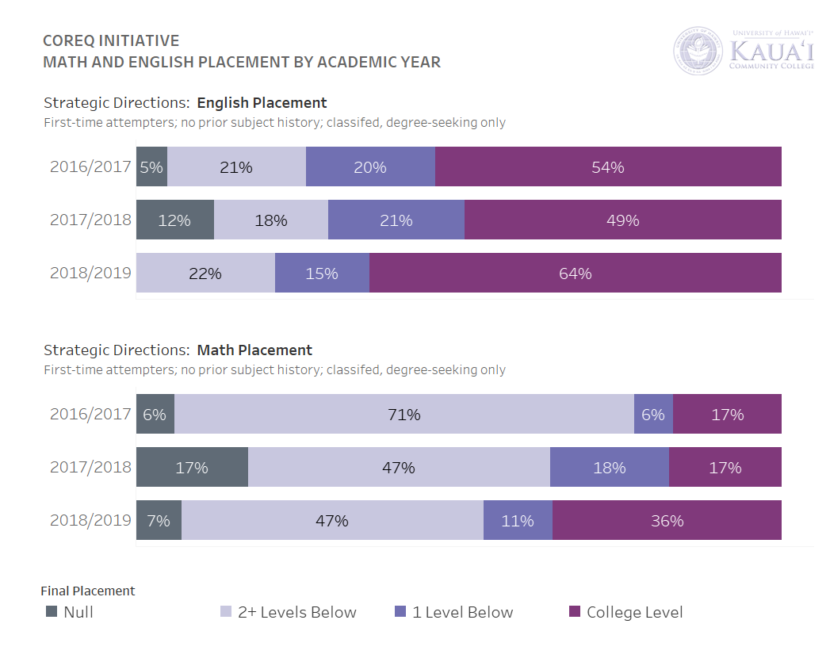
Placement
Notes:
NEED TO UPDATE – PENDING JARED AT SYSTEM

Slide 15
Other Successes
Accreditation
Improved visual data
Improved website
Increased onboarding
Increased OCET revenues
New APRU template
Electronic catalog
Strengthened early college
Entrepreneurship activities

Slide 16
Budget Situation
Our reserves are falling due to low enrollment, filling positions, higher operations costs, governor’s budget restrictions, and recent failure to meet performance goals.
Currently we are healthy but if we do not make slightly uncomfortable cuts now, we will be in deficit over time
We have invested in personnel but that means we need to tighten our belts elsewhere.
UHF Ed White and Development funds are also low because they have been used to compensate for low general and TSF funds.

Slide 17
Budget Realities and Guidelines
Allocations to areas of the college will not be as high as they have been.
The funding course for repair and maintenance comes from a different source so cannot be directed to cover other operations
There will be no automatic refilling of positions, travel will be more closely scrutinized, overtime and overload will be limited.
Travel, overtime and overload, and purchases over a threshold will not be reimbursed without prior approval.
Be conservative in spending and stay within your budget
Notes:
Overtime and overlo

Slide 18
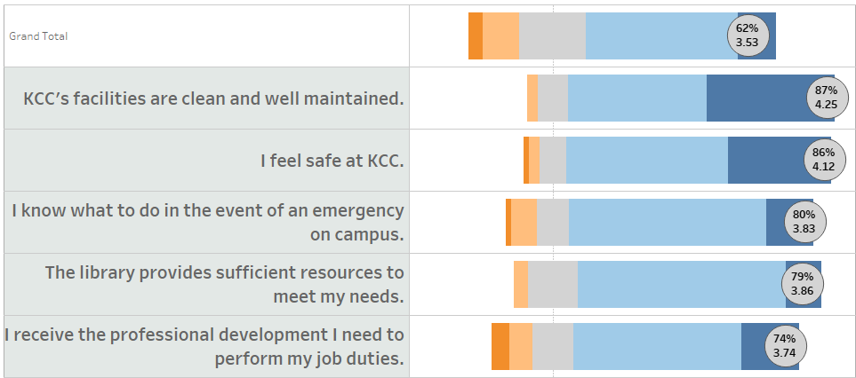
Campus Survey: Top 5 Items for Faculty/Staff
Student
Comparison
-6
Notes:
Survey used for benchmark, every 2 years. Need more people to respond. Student Comparison provided. X means it was not in the top 5 items for the comparison group. College Conversation September 9 12-1:30. TBA—ask Amanda

Slide 19
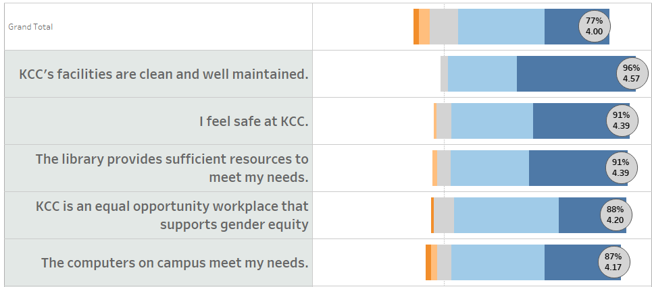
Campus Survey: Top 5 Items for Students
Faculty/Staff
Comparison
+15
+ 9
+ 5
+12
-31
-20
Notes:
Faculty/Staff Comparison provided. Percent positive point difference indicated in comparison. X means it was not in the top 5 items for the comparison group. Interesting that gender equity is so much lower for Faculty/Staff…may or may not want to include difference for X values – might provoke non-constructive discussion. Students only had 5% no opinion vs. Employee 3%.

Slide 20
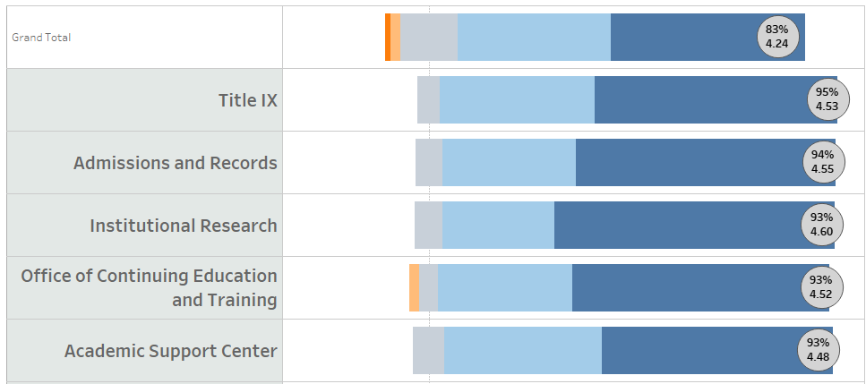
Top 5 Departments for Faculty/Staff
How often does ____________ offer accurate service/information?

Slide 21
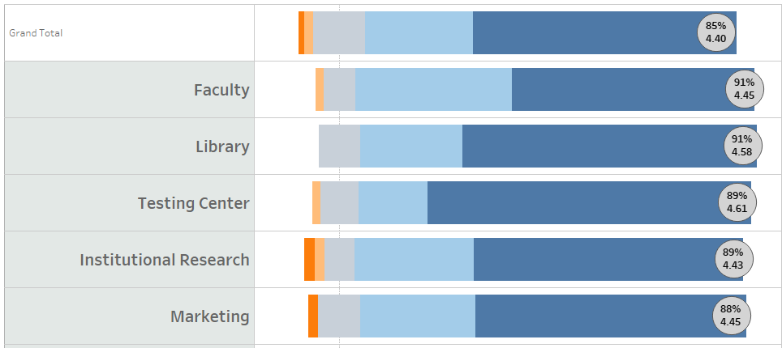
Top 5 Departments for Students
How often does ____________ offer accurate service/information?

Slide 22
Most N/A Response Departments
Faculty & Staff
Students
Grants | 51%
Student Government | 50%
Student Life | 49%
Scholarship Services | 46%
University Center | 43%
Marketing | 34%
Financial Aid (FASFA) | 32%
Testing Center | 30%
Title IX | 30%
Academic Support Center | 29%
Grants | 44%
Title IX | 43%
Marketing | 42%
OCET | 40%
Institutional Research | 39%
Human Resources | 35%
University Center | 32%
IT | 32%
Student Life | 32%
Student Government | 32%
Notes:
Green items are shared highest N/A departments across both populations. For future surveys we may want to add explanation around N/A and No Opinion responses to ensure they are being selected when appropriate.

Slide 23
Kauai CC Priorities 2018-2021
Increase the number of graduates
Increase the number of Native Hawaiian graduates
Increase the number of low income graduates
Increase the # of students who transfer to four-year degrees
Reduce time to degree: increase retention and credit accumulation.
Strengthen Distance Education Offerings
Increase recent high school graduates
Increase international students enrollment
Notes:
You will see how we are doing with the first three priorities, but we need more data on the 4th one.

Slide 24
UHCC Student Success Roadmap
Completion to Transfer
To streamlined Transfer
(75%-100%)
Connection
Interest to Registration
Entry
Registration to completion of college level Math and English(0-25%)
Progress & Learning
Entry into Program of Study to 75% completion of requirements
(25%-75%) &
Completion to Career
To receipt of credentials with labor market value
(75%-100%)
Notes:
Will customize HON and KAP graphics and headings

Slide 25
Our work for this year
Focus attention on the Student Success/Campus Roadmap to boost enrollment and completion-enrollment management
Strengthen our commitment to being a place-based and indigenous serving institution.
Integrate sustainability principles in all that we do- cultural, economic, environmental, and social.
Follow up on accreditation recommendations, improvement plans and QFEs.
Notes:
Talk about upcoming title III, one theme, one community, care center.

Slide 26
Kauai Aloha + Challenge
Notes:
UN reports on climate change –food production and land use, water, refugees. Kauai sea level rise, ocean acidification,

Slide 27
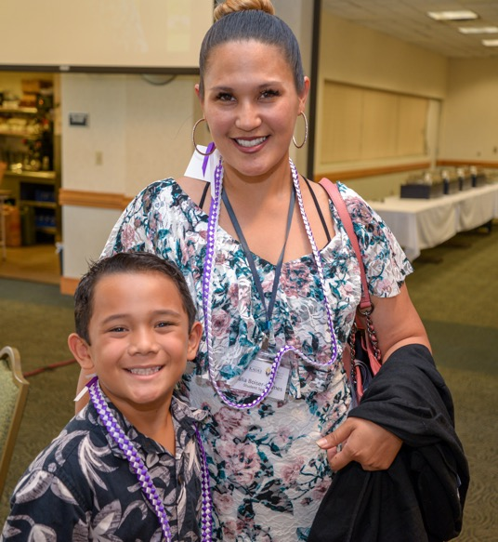
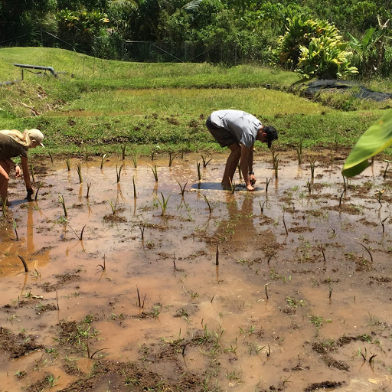
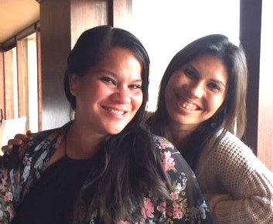
Kaua`i Community College’s Core Values
` o h a n a
` for `aina
o for ola
h for ha`aha`a
a for ahonui
n for "nānā i ke kumu"
a for aloha
Notes:
All had input. Final task force. Pomai, Eric San George, Kalei, Lahea, Brian, Frankie and me. Patience, enduring.
Mauna Kea. Kapu Aloha

Slide 28
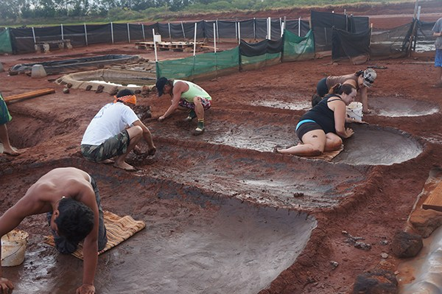
Responding to Mauna Kea and Local Issues of Resistance
Forums for Employees and Students:
Tuesday Sept 3 12-2 FA Wednesday Sept 4 12-2
FA Tuesday Sept 3 4-6 TBA
Kapu Aloha
Creating a safe place to share thoughts and emotions
Reminding students and faculty/staff of educational kuleana

Slide 29
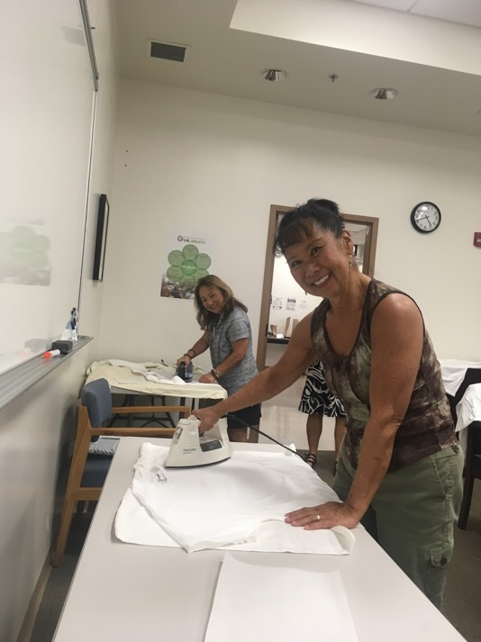
Imua!
‘A‘ohe
hana nui
ke alu ‘ia.
No task is too big
when done together
by all.

