Slide 1
I wish my teachers knew
Results of a study by the Wo Learning Champions Generation XII

Slide 2
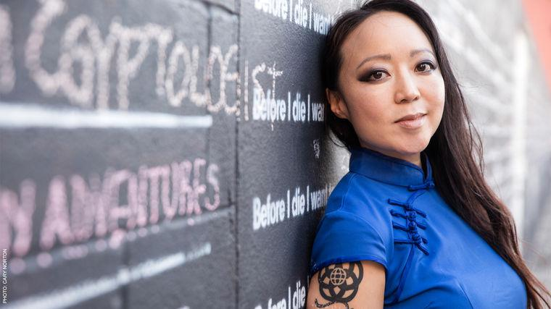
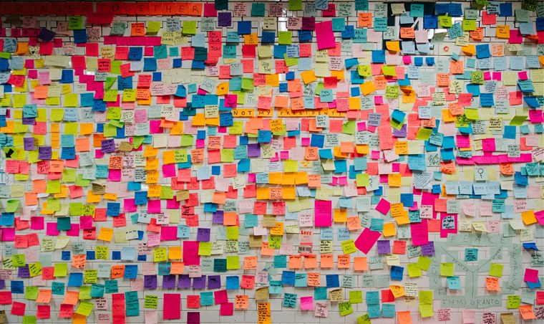
Inspired by TED Talks: Candy Chang
https://www.ted.com/talks/candy_chang_before_i_die_i_want_to?utm_campaign=tedspread&utm_medium=referral&utm_source=tedcomshare
Notes:
Inspired by the death of a loved one, Candy Chang converted a crumbling New Orleans house into a participatory installation with the prompt, “Before I die, I want to…”

Slide 3
I Wish My Teachers Knew…
This project will:
Provided students an opportunity to express their challenges and aspirations, and in so doing highlight the issues that matter to them as these issues relate to diversity on each of the different campuses;
Provided students with a vehicle to build bridges with others who share commonalities and/or who can serve as advocates;
Increased awareness across all sectors of the campus community (students, faculty, APT, administrators, civil servants) of the various factors that define and shape our students' experiences of college;
Inspired various campus sectors to mobilize around the issues that come to light;
Encouraged administrators to dedicate permanent public spaces on their campuses for students to express themselves in ways that enhance their college experience.

Slide 4
What the Wo Learning Champions did:
Notes:
Invite students to share feedback via anonymous speech boards/drop boxes on campus or via online submissions.
Compile student data at each campus and across the UHCC system.
Analyze for commonalities and identify unique qualities and/or experiences at individual campuses and throughout the UHCC system.
Recommend strategies to address areas of need, especially in services and instruction for students.

Slide 5
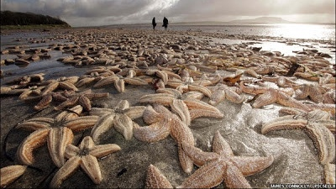
Small changes can make a big difference

Slide 6
Overall Results

Slide 7
Results by Category

Slide 8
Results by Category

Slide 9
What did we learn from our students?What are we going to do about it?

Slide 10
Teaching Methods
Have students say names multiple times
Create a routine
Ask other students to answer questions
Post lecture notes in Laulima ahead of time
3-2-1: 3 key points, 2 connections, 1 question
Ask students, “What’s the next step?” This will slow you down.
Share links to other resources

Slide 11
Group work
Professional development
Don’t use vague descriptions
Assign/define roles, and monitor
Asynchronous discussions for online classes.
Give a group grade and an individual grade.
Is grading group work contrary to building relationships?
Tell students what they are doing well.
Jigsaw

Slide 12
Personal Life
Affordability - Consider OER or low cost resources
Keep some food in classroom or office
Encourage students to share
It’s hard to help students if they don’t share what’s going on
Secrets of Success - Study skills groups @ KapCC
Hinet, food pantry
Ask student what he/she needs
Hui Haumana - Maui (food pantry, bus passes, no questions asked)

Slide 13
LMS/Online
Make it clear when you’re available
Send students proposed schedules with amount of time per assignment.
Demonstrate how to use. (Reserve computer room, create a video)
Use Google Hangout
Schedule face to face lab
Use asynchronous communication
Screencast to record videos to educate students/faculty about online classes
Make sure you understand platform before you use it!

Slide 14
Time
Do an assessment of your assignment before you assign it.
Talk to students one on one.
Group projects can be done in class
Help students map out schedules
For groupwork, allow to do individual parts outside of class, meet in class.
Be clear about expectations

Slide 15
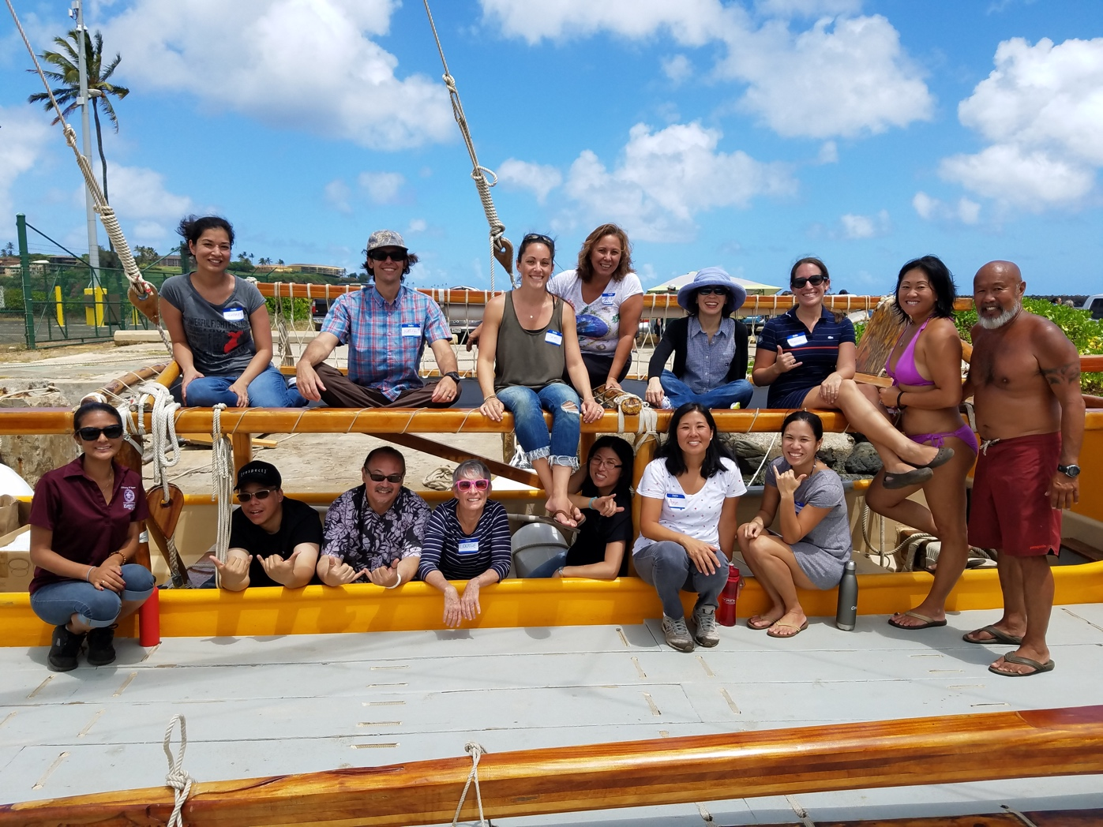
Mahalo from Wo Learning Champions, Generation XII
Kesha Kubo, Hawai‘i Community College
David Tsugawa, Hawai‘i Community College - Palamanui
Ann Abeshima, Honolulu Community College
Cassandra Kam, Honolulu Community College
Alfie Gonzales, Kapi‘olani Community College
Kelli Nakamura, Kapi‘olani Community College
Cheryl Stiglmeier, Kaua‘i Community College
Dennis Chun, Kaua‘i Community College
Alyssa MacDonald, Leeward Community College
Summer Miles, Leeward Community College - Wai‘anae
Neil Stotts, University of Hawai‘i Maui College
Samantha Bowe, University of Hawai‘i Maui College
Audrey Badua, Windward Community College
Trish Brubaker, Windward Community College
Louise Pagotto, Kapi‘olani Community College (convener)

