Slide 1
College Conversation
Sustainability Matters@KCC
Monday, December 2, 2019
12:15 – 1:30PM
OCET Room 105

Slide 2
Sustainability Survey
Administered 9/3/2019 to 9/16/2019 via Google Forms
Survey Intent:
Gauge interest and awareness of Campus Sustainability Initiatives to inform planning and evaluation
9 Questions
107 Respondents
Notes:
Select PDF Image to open Instrument

Slide 3
Survey respondents represent a variety of academic areas

Slide 4
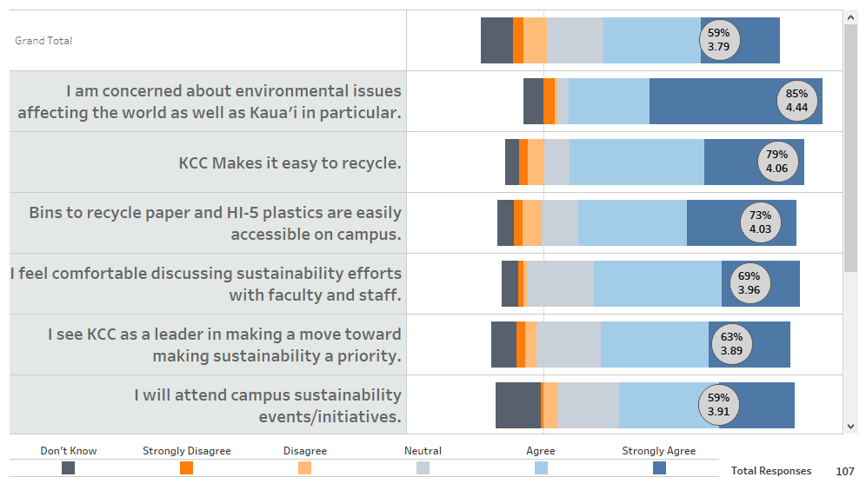
Sustainability is a concern for KCC
Most Positive Response for Employees and Students at KCC:

Slide 5
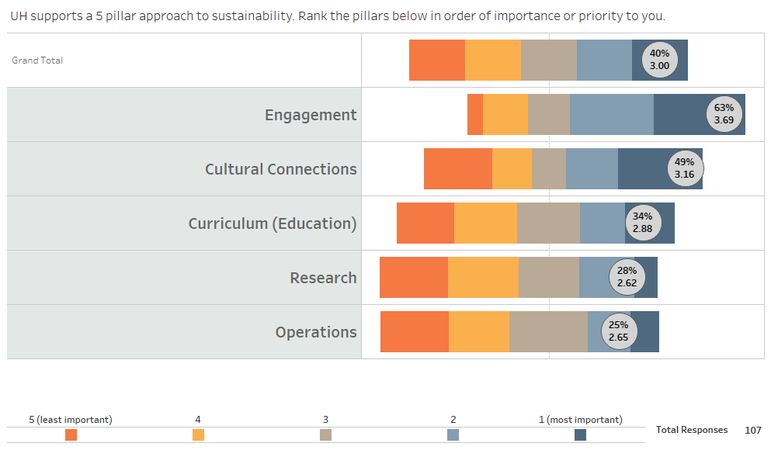
Respondents indicate that engagement is the most Important Pillar

Slide 6
But we do not feel well informed
Employees and Students at KCC:

Slide 7
Students indicate they are significantly more informed than Employees
Students at KCC:
Employees at KCC:

Slide 8
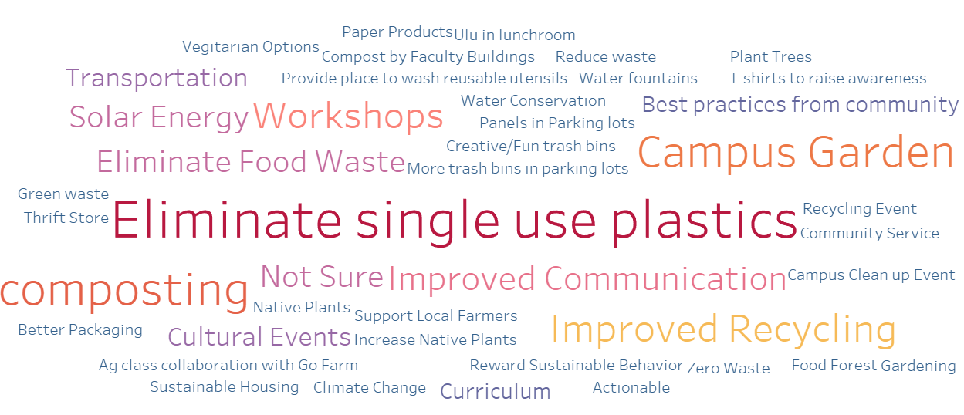
What sustainability projects/initiatives would you like to see on campus?

Slide 9
Sustainability Business Forum
https://sbf.hawaiigreengrowth.org/
https://dashboard.hawaii.gov/aloha-challenge

