Slide 1
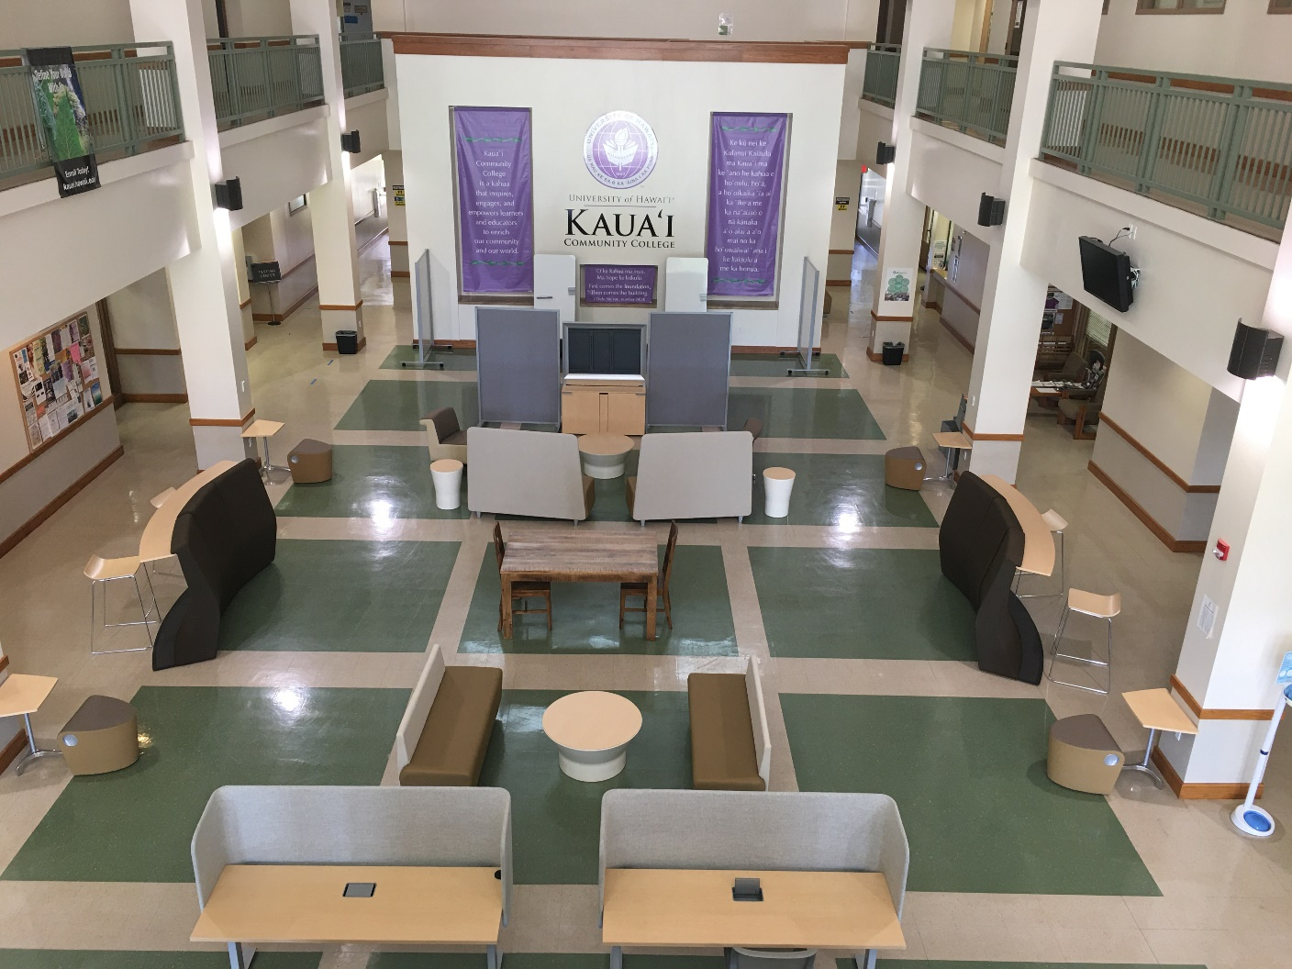
TITLE III UPDATES
2020
FALL

Slide 2
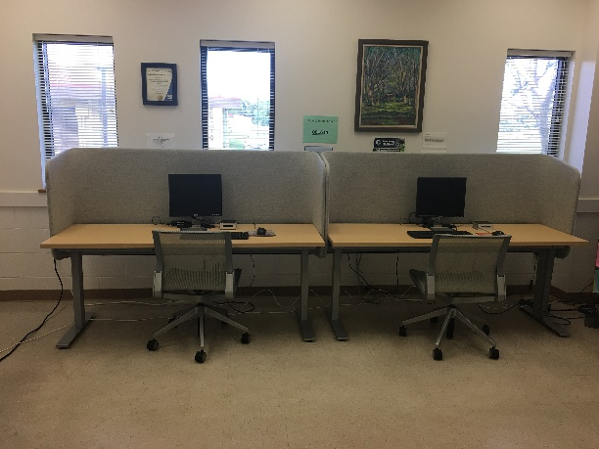
Crossing Cultures: No Cost Extension
Renovation of the OSC Lobby with furniture, technology and wall decor
Technology and furniture purchased for financial aid, advising, career center, and registrar offices
Continued work on the wa'a (Dennis Chun)
Purchased educational supplies for Pre-Engineering, Early College (for distance teaching) and CogsGo! (to be mobile with technology)

Slide 3
Hired Positions
Grants Program Planner
Temporary Project Support Assistant
Layla Lankford
Andrea Erichsen

Slide 4
Kelekaˋa Hoˋonaˋauao: KauCC
(Collaborative Grant with UHWO)
In process of upgrading three Library spaces for distance education (furniture, computers, and OWLs); LIB 103, 104, and 122
Develop 2+2 Pathways for Native Hawaiian students from KauCC to UHWO distance education programs (Business AS degree: courses redesigned for online offerings during Summer 2020)
Articulation Agreements (Business)

Slide 5
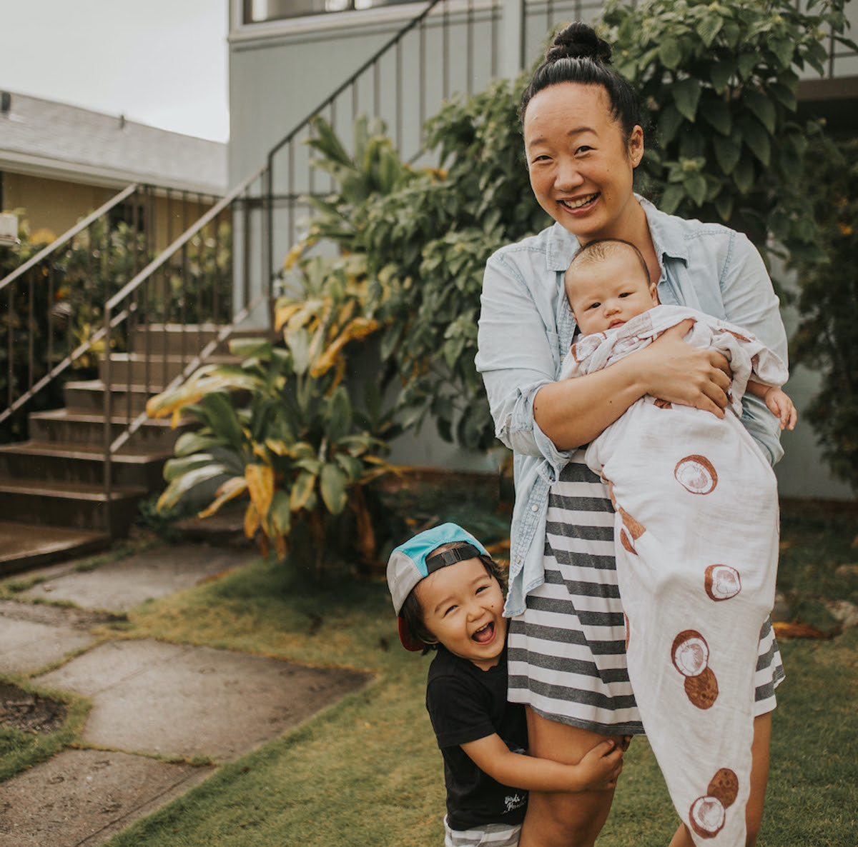
Kelekaˋa Hoˋonaˋauao: UHWO (Collaborative Grant with UHWO)
Hired Distance Education Support Specialist to serve Kauaˋi students
Regional accreditor approved offering B.Ed in
secondary education (English Language Arts
concentration) online; curriculum prepared
during summer 2020 for AY 21-22 launch
BA in Humanities (Hawaiian and Pacific
Studies concentration) being developed for
AY 21-22 launch
Anuhea
Piliere

Slide 6
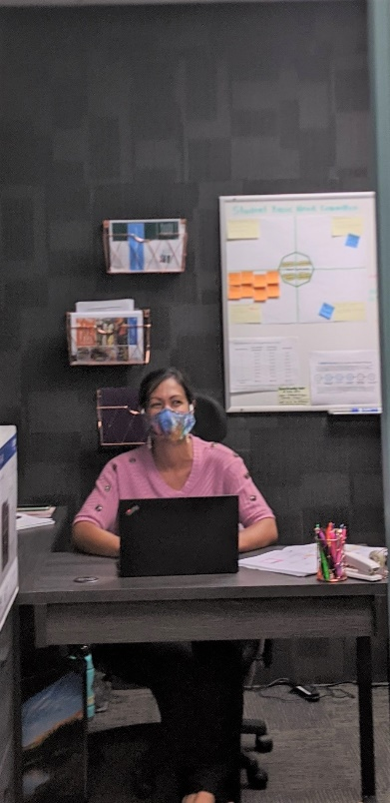
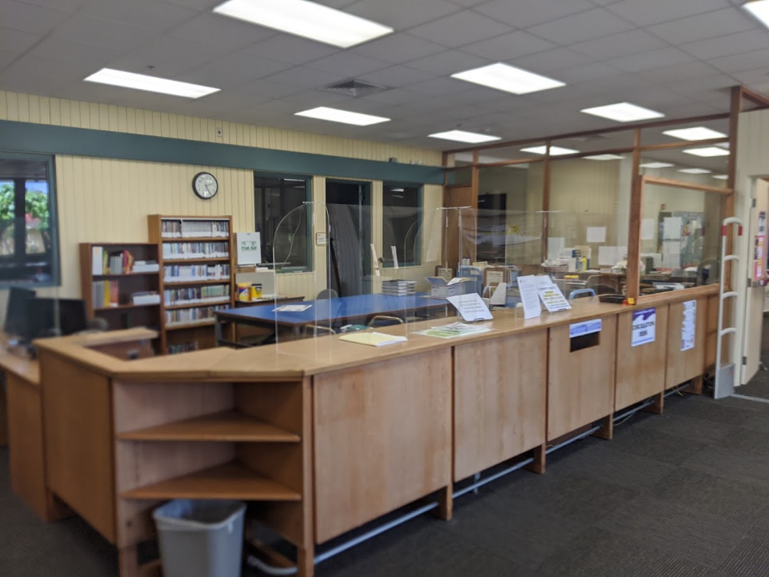
Kahua Paepae Ola
Moved Hale Malama (Cares Center) to the Library for better student access
In process of purchasing modern furniture for Academic Support Center and updating Library Circulation Desk

Slide 7
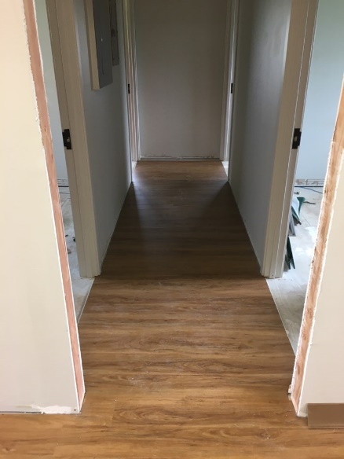
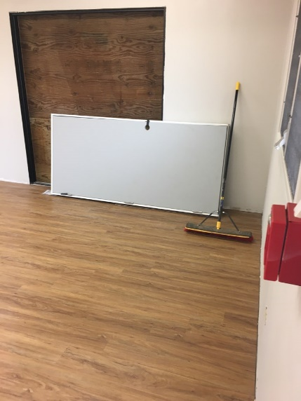
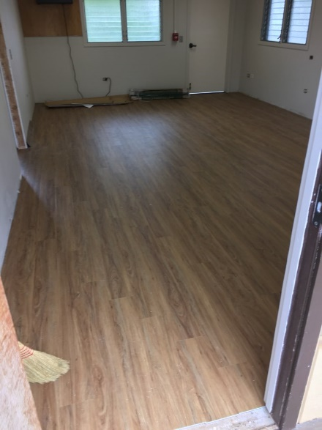
Kahua Paepae Ola
Renovated student lounge area for the Hawaiian Studies kauhale
Created a free IS course for Kipaipai students (1st Year) to assist in college transition and retention into the second year
Planned renovation to shade house for native Hawaiian plants

Slide 8
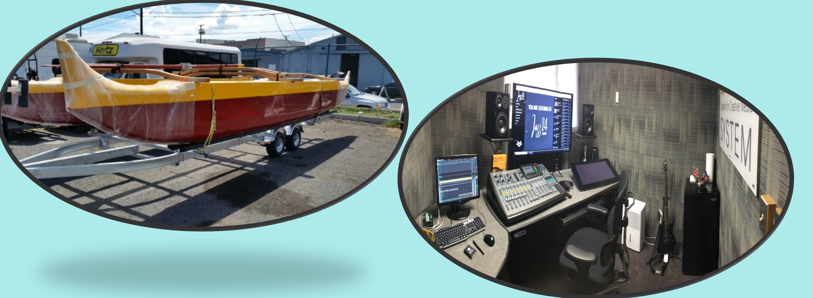
MAHALO!

