Slide 1
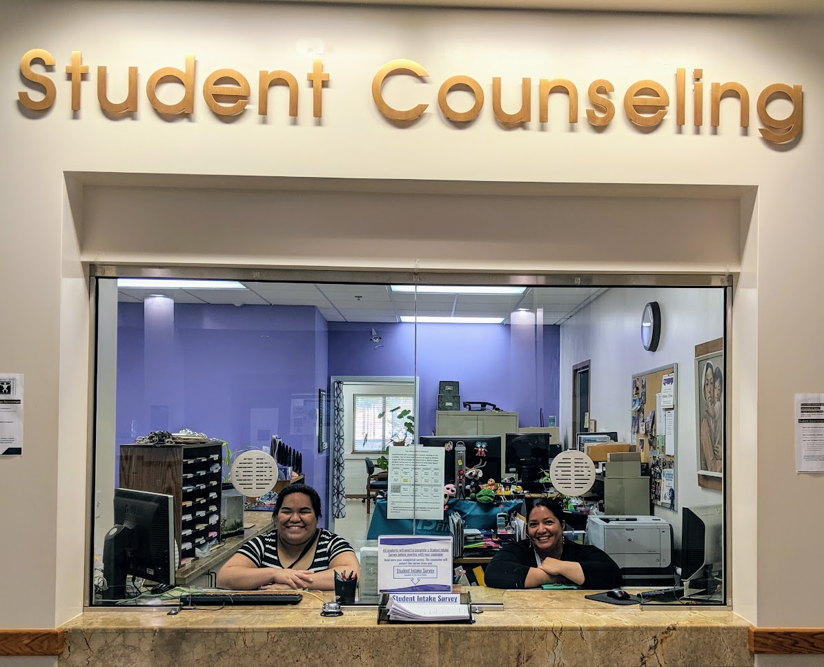
Student Affairs, Spring 2020

Slide 2
Welcome and Goodbye
Welcome Clarice!
Welcome Julian!
Happy retirement Anne McKenna!

Slide 3
QFE – Integrated Career and Academic Services
#Find your future 11th and 12th grades at KCC
High School Counselor Event at KCC
Enrollment Days at High Schools
Application Days at HS with Career Services
Placement Assessment at HS
Mandatory Academic Advising
January
September
February
February - March
April
(For first -time freshmen)
All Events include Financial Aid !

Slide 4
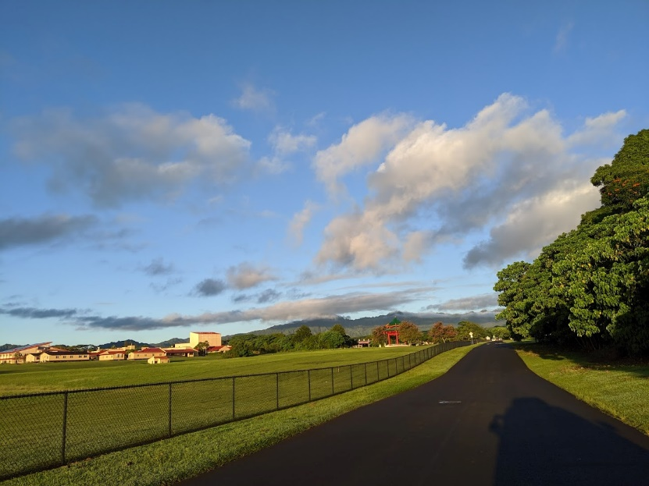
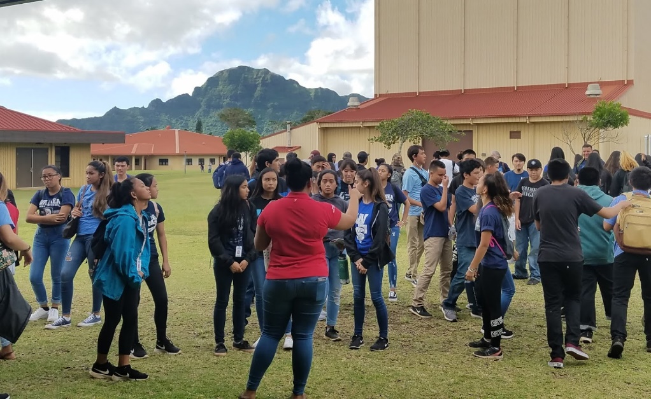
# Findyourfuture Events
Kapaa High School, Thursday January 23rd
Kauai High School, Friday January 31st
Waimea High School, Friday February 7th

Slide 5
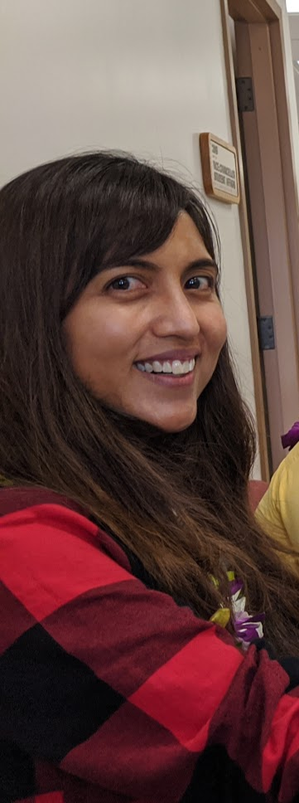
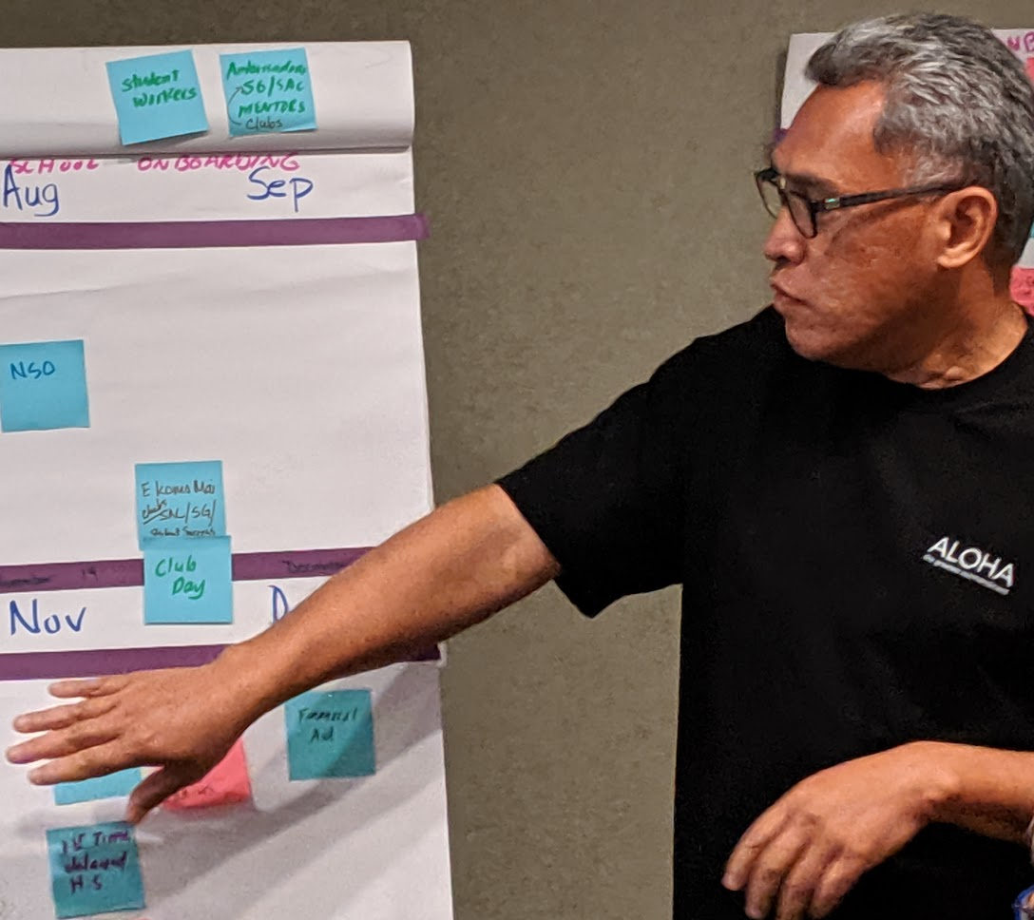
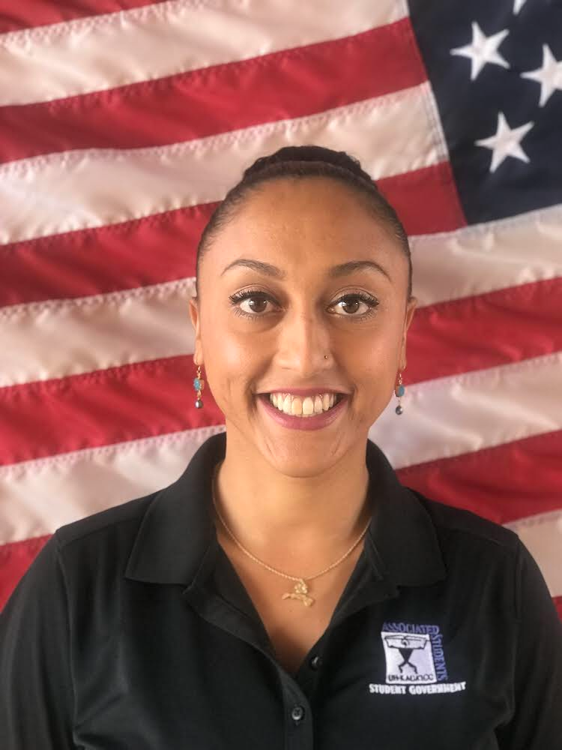
Title lX
Goodbye Teresa Tumbaga and Keahi Kahui
Hello Isaiah Kaauwai – Interim Title lX Coordinator
Hello Maili Ornales – Confidential Advocate

Slide 6
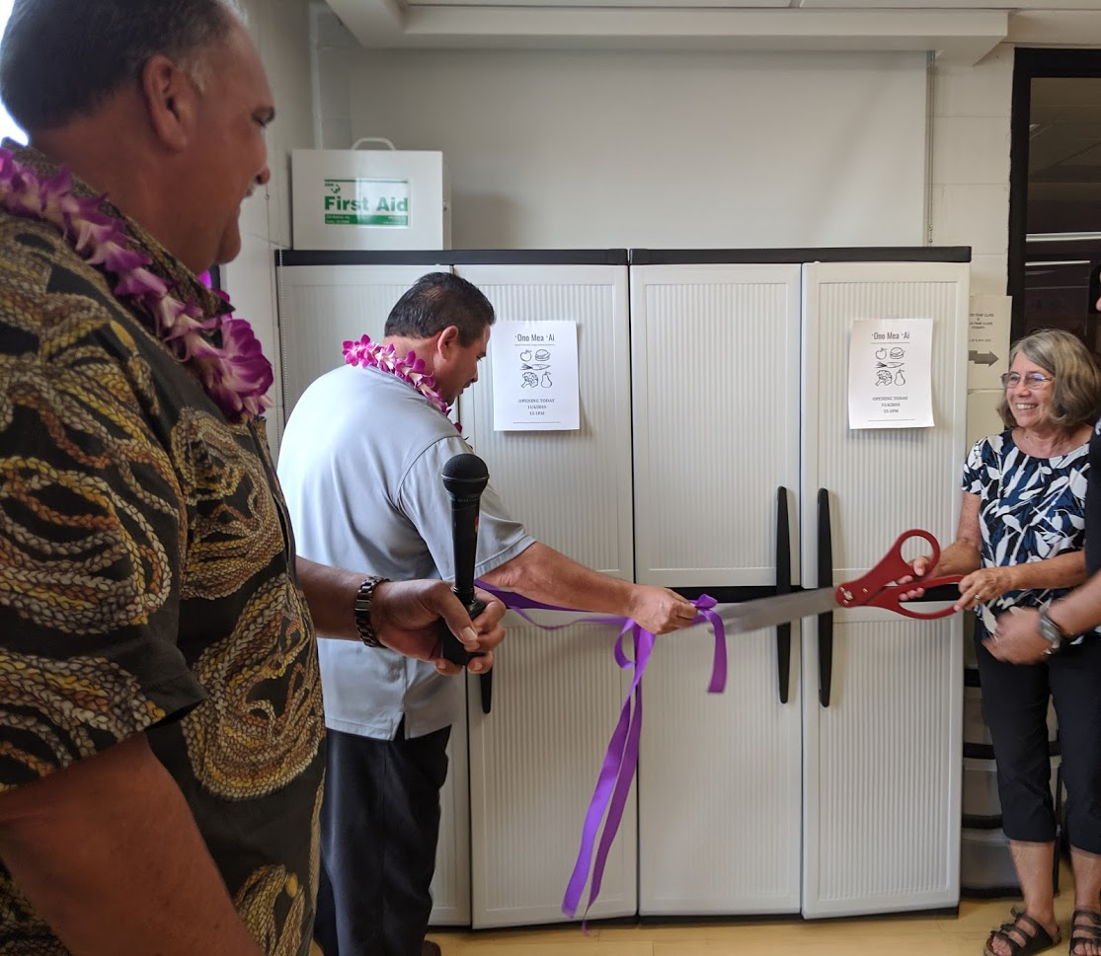
Care Center
Title 3 Grant
MSW Interns – Lani Nagao and Juliana Olds
Food Pantry – Ono Mea Ai

